Slide 1
Interactive Story Telling

Slide 3
Gary The Gull

Slide 4
Attempt demo

Slide 10
Pros
Cons
Replayability
Control the overall story
Increased immersion
Engagement
Multiple playthroughs
Lots of edge cases
Had to force the narrative at times

Slide 11
Gaze Based Interaction
Staring at or away from something triggers an action

Slide 12
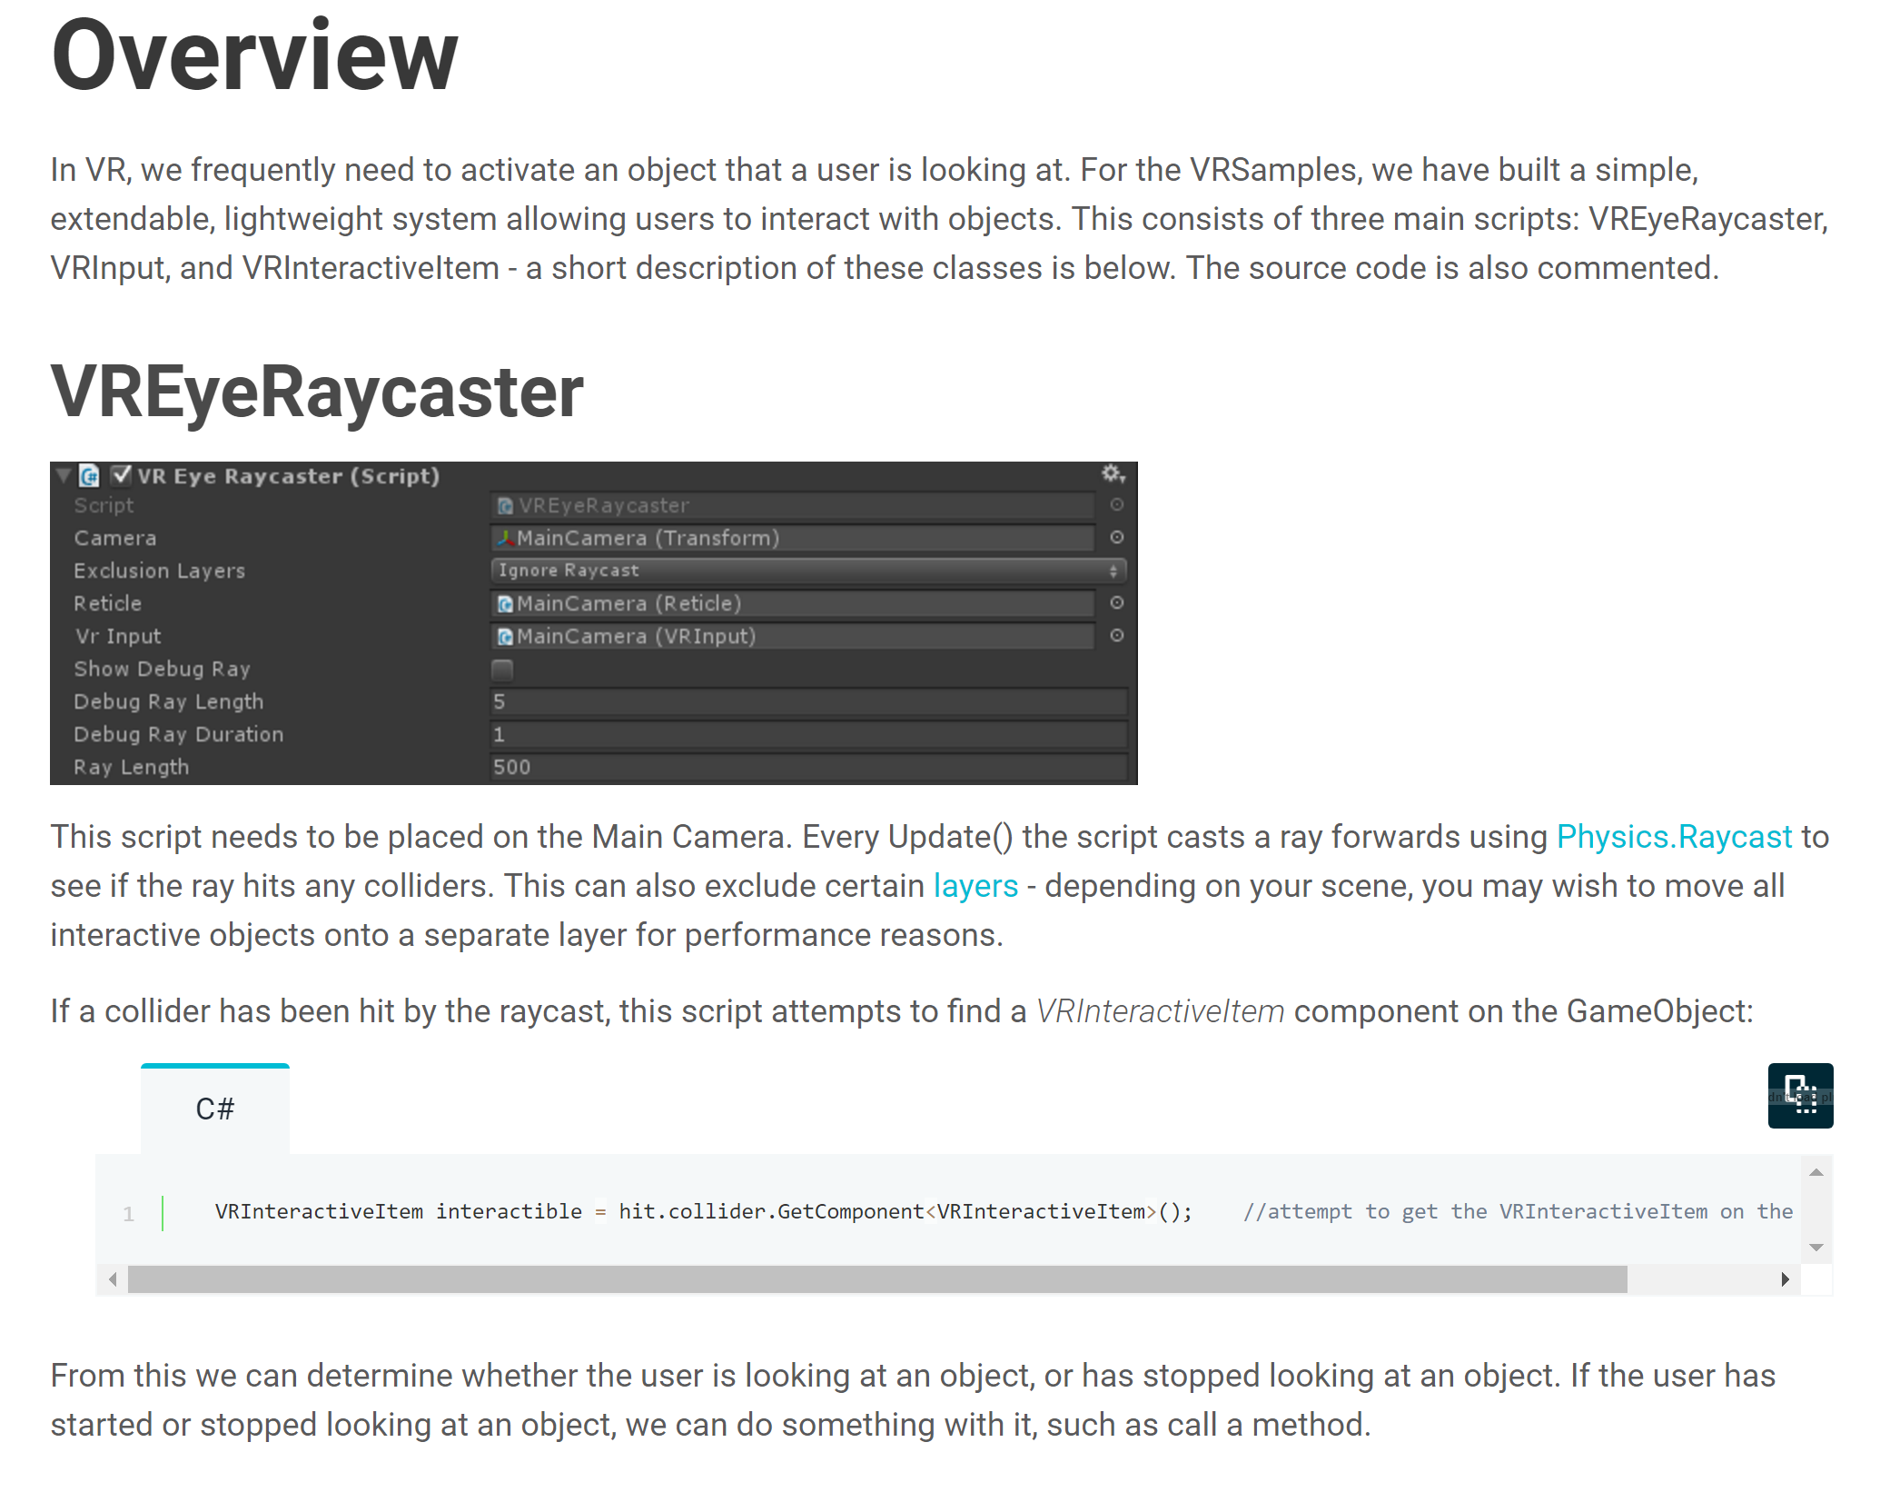
https://unity3d.com/learn/tutorials/topics/virtual-reality/interaction-vr
Notes:
https://unity3d.com/learn/tutorials/topics/virtual-reality/interaction-vr

Slide 13
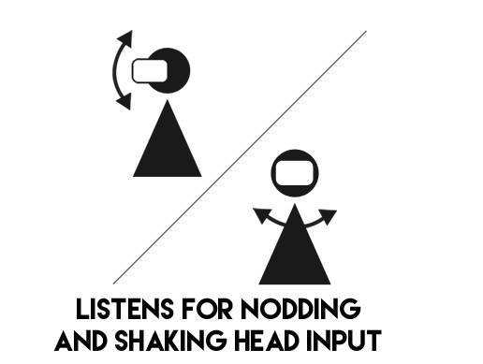
Head Gestures
Use velocity and direction of player’s head to determine intent

Slide 14
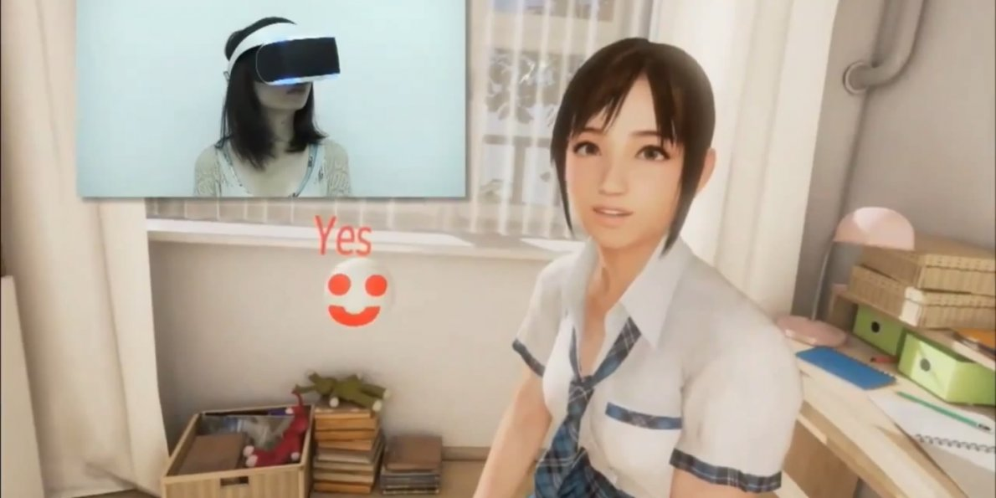

Slide 15
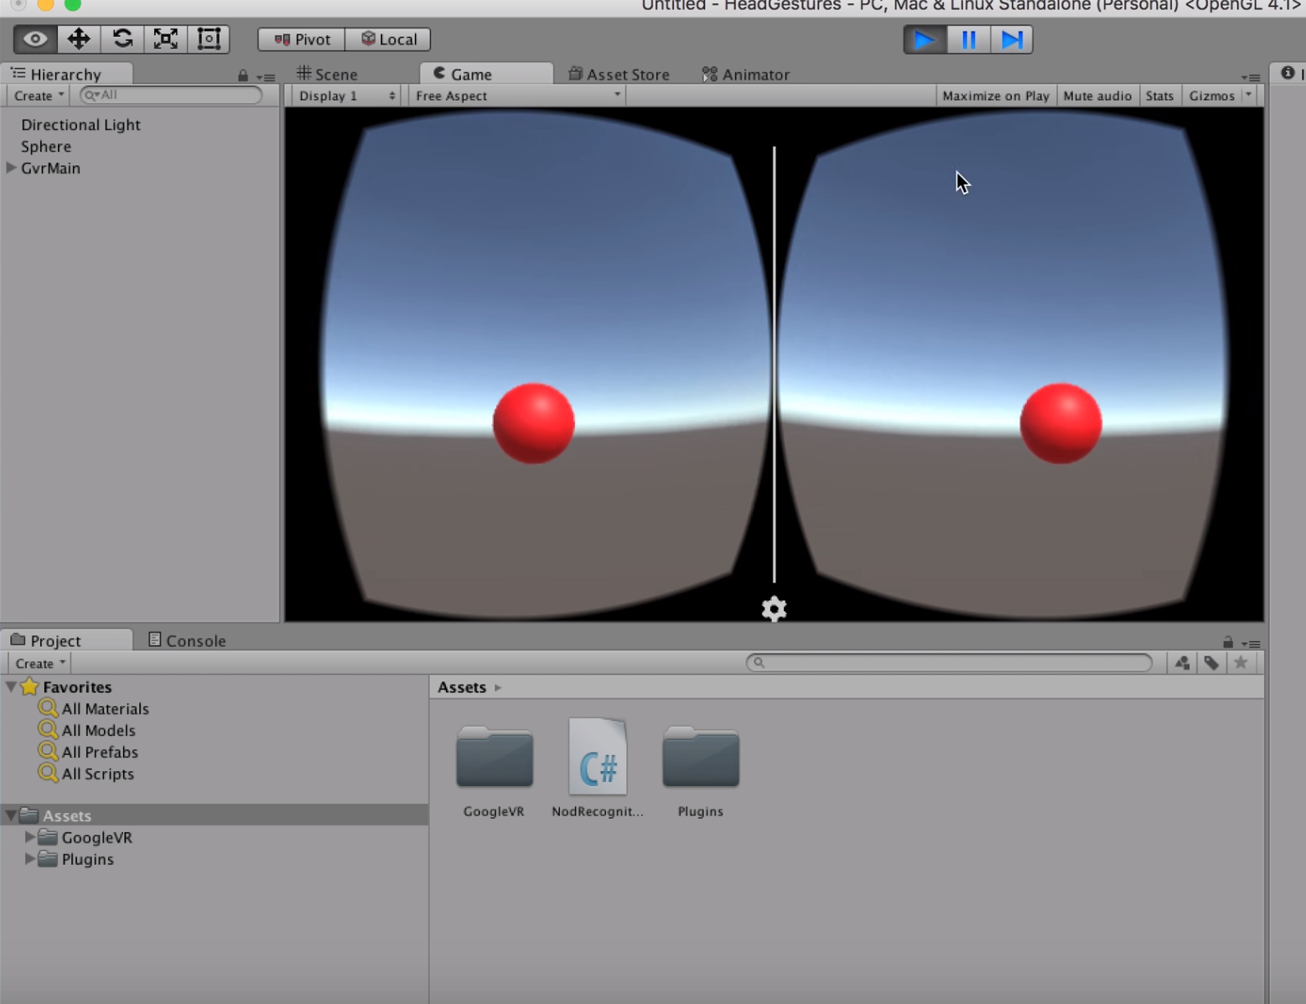
https://www.youtube.com/watch?v=3icqAJnZF8Y
Notes:
https://www.youtube.com/watch?v=3icqAJnZF8Y

Slide 16
Distance
How close is the player?
How close is something else?
Reaction based on distance between virtual object and headset

Slide 17
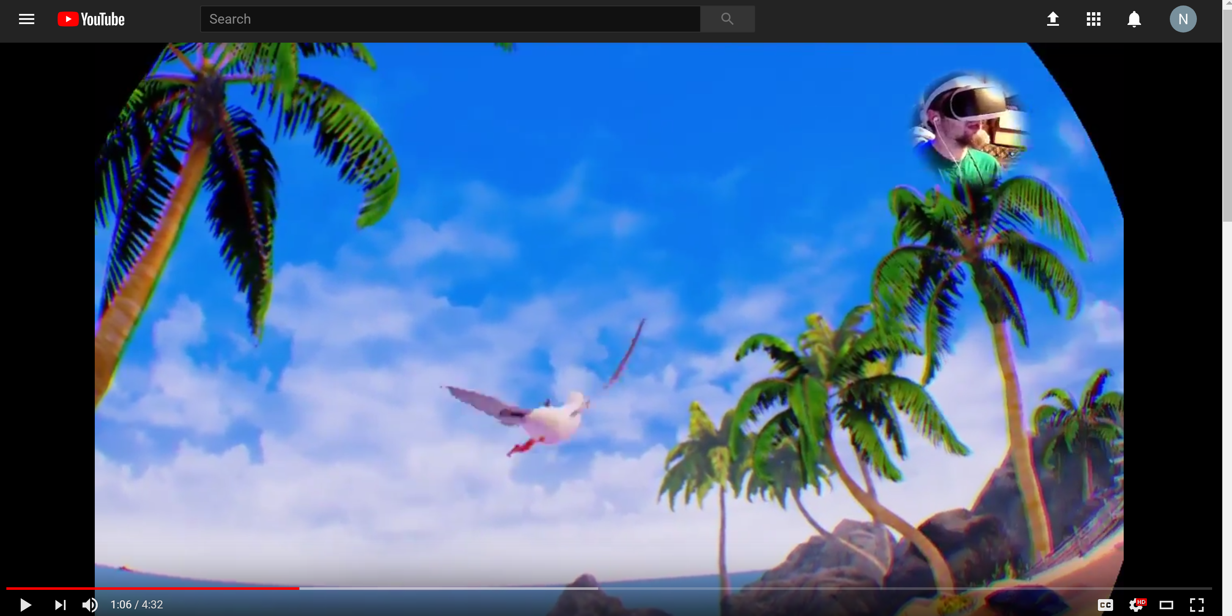
https://www.youtube.com/watch?v=J2FwN7NaEu0

Slide 18
Speech Recognition
Limit to most common words
Extremely complicated
Use Magic Tricks

Slide 19
Notes:
https://www.youtube.com/watch?v=kiCECLYvs54

Slide 20
Speech Recognition Tools
CMU Sphinx https://cmusphinx.github.io
Google Cloud Speech https://cloud.google.com/speech/
Facebook Wav2Letter https://github.com/facebookresearch/wav2letter

Slide 22
